Slide 1
ECLT 5830
Network and Web Programming
HTML Forms

Slide 2
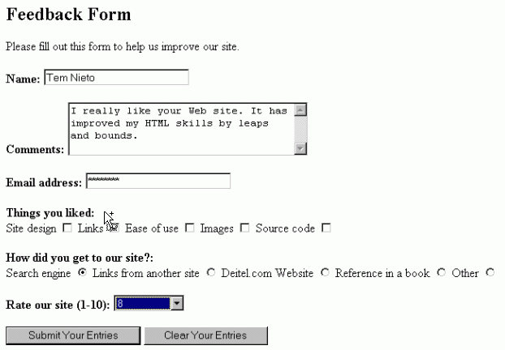
Introduction
An HTML form is used to collect user input.
The collected input is typically sent to a server-side program to process
  The collected input can also be processed using JavaScript on the client machine

Slide 3
HTML Forms (form)
The <form> element is used to create an HTML form to collect user input.
A form can contain input elements (also known as controls) like text fields, checkboxes, radio-buttons, submit buttons, select menus, text area, field set, etc.
Not the only way to collect user input
  A UI can also be constructed using CSS and JavaScript.
Ref: http://www.w3schools.com/TAGS/tag_form.asp

Slide 4
<!-- Only showing the content in the body element -->
<h2>A Sample Form Using GET</h2>
<form action="http://localhost:8088/SomeProgram"
method="GET">
First name: <input type="text" name="firstName" value="">
<br>
Last name: <input type="text" name="lastName" value="">
<br>
<input type="submit" value="Submit Query">
</form>
Example: A form with three controls: two text fields and one submit button

Slide 5
Attribute action of element form
Every form element has a required attribute action, which specifies where the form data are to be sent.
e.g.,
<form action="http://localhost:8088/SomeProgram">
specifies that the form data are to be sent to a server-side program corresponds to the URL http://localhost:8088/SomeProgram.
Note:
  localhost (or IP 127.0.0.1) is a qualified name referring to the local machine.
  8088 is the port number in which the web server in this example is listening to. The server admin can change this number. If not set, port 80 is assumed.

Slide 6
Form Submission Methods
Two methods to send form data
  GET
    Data are encoded in the Request-URI of a HTTP request.
    e.g.: <form action="…" method="GET">
    The default method
  POST
    Data are encoded in the body of a HTTP request .
    e.g.: <form action="…" method="POST">

Slide 7
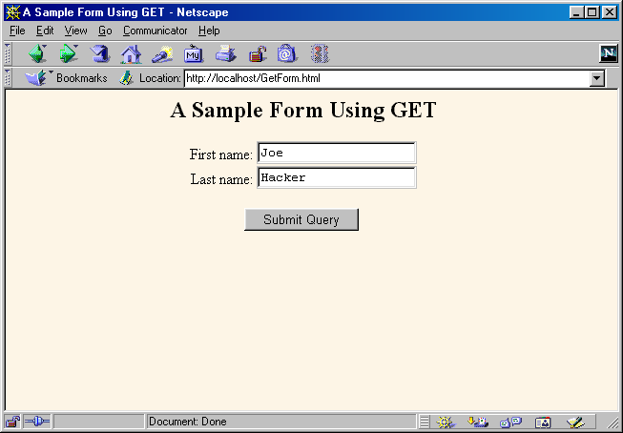
Form Submission Using GET Method

Slide 8
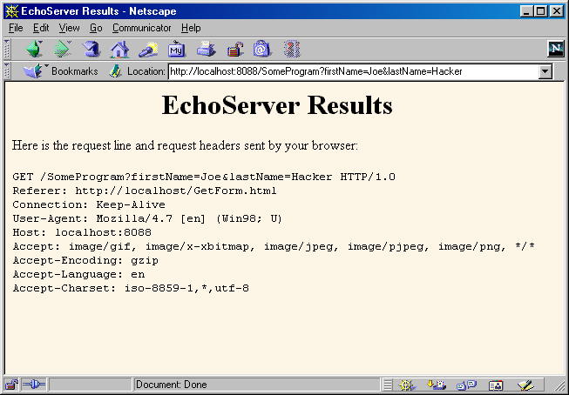
Submission Result Using GET Method
Request-URI at the Request-Line of a HTTP request

Slide 9

Form Submission Using POST Method

Slide 10
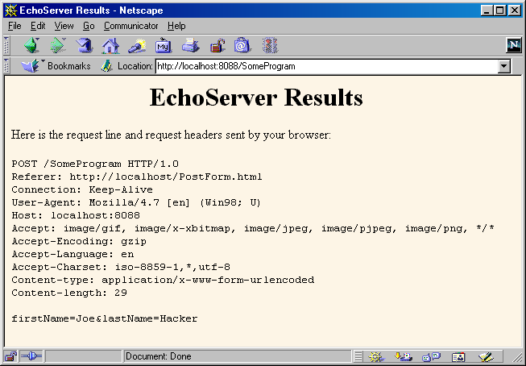
Submission Result Using POST Method

Slide 11
GET vs. POST
GET
  Data are encoded in the "Request-URI" of a HTTP request
  The default method
  Can only accommodate limited amount of data (browser dependent)
  Can be bookmarked (persistent)
POST
  Data are encoded in the body of a HTTP request
  Can accommodate huge amount of data
  More secure (in the sense that the submitted data are not persisted by the browser or by the server)
  Cannot be bookmarked

Slide 12
Form Data
Data collected in a form are sent to the server program as name=value pairs.
  name is the name assigned to a control and value is the data collected by the control.
The name=value pairs are separated by ‘&’ from each other.
With the GET method, the encoded data are appended to the URL of the server side program (separated by a ‘?’)
e.g.:
http://localhost:8088/SomeProgram?firstName=Joe&lastName=Hacker
Query string

Slide 13
URL Encoding
Some characters have to be specially encoded in the URL. e.g.:
  '/' as %2F, '&' as %26, '?' as %3F, ' ' as '+' or %20, '+' as %2B, …
  Full list: http://www.w3schools.com/html/html_ref_urlencode.asp
  e.g.: The value
  Tom & Jerry
  may appear in the URL as
  Tom+%26+Jerry
Useful if you want to
  Understand or modify the data encoded in the URL directly
Form data is automatically encoded before they are sent to the server.

Slide 14
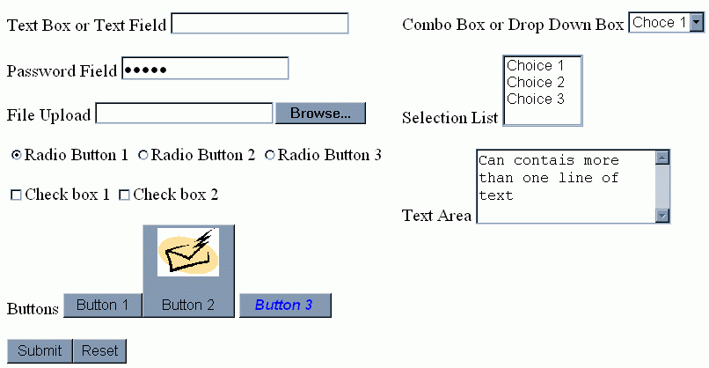
Controls

Slide 15
Controls
Each control should have the required attribute "name" in its tag. e.g.:
<input type="text" name="a_unique_name" … >
<textarea name="another_unique_name">
The value of a control is a character string. (Some controls can have multiple values)

Slide 16

Text Box or Text Field
<input type="text"
name="LoginName"
value="Initial Value"
>
Element: input
Attributes
  type: must be "text"
  name: name of this form element
  value: (Optional) Initial value place in the text box
  Other optional attributes: readonly, maxlength, disabled
Purpose
  For collecting input in the form of a single line text

Slide 17

Password Field
<input type="password"
name="Pass">
Note: The box is initially empty. The value is entered through keyboard.
Element: input
Attributes
  type: must be "password"
  name: name of this form element
  Other optional attributes: value, disabled
Purpose
  For collecting sensitive data such as password which you don't want to reveal on the user's web client
    The collected value is sent as plain text!
    POST method should be used if a form contains password field.

Slide 18
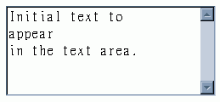
Text Area
<textarea name="name"
cols="25" rows="5">
Initial text to
appear
in the text area.
</textarea>
Element: textarea
Attributes
  name: name of this form element
  cols, rows: number of columns and rows measured in characters
  Other optional attributes: disabled, readonly
Purpose
  For collecting text input that spans multiple lines
  For displaying multiple lines of texts such as user agreement
  Everything, including HTML tags, space, and newline characters that appear in <textarea> … </textarea> are preserved.

Slide 19

Check Box
<input type="checkbox"
name="coke" checked> Coke<br>
<input type="checkbox"
name="fries"> Fries
Element: input
Attributes
  type: must be "checkbox"
  name: name of this form element
  Other optional attributes: disabled, checked, value
Purpose
  To allow users to select or unselect an item

Slide 20

Radio Button
<input type="radio" name="lang"
value="Java" checked> Java<br>
<input type="radio" name="lang"
value="C++"> C++<br>
<input type="radio" name="lang"
value="JavaScript">
JavaScript<br>
Element: input
Attributes
  type: must be "radio"
  name: name of this form element
    Radio buttons belonging to the same group have the same name
  value: value of each element
  Other optional attributes: disabled, checked
Purpose
  To allow users to select one of several items

Slide 21
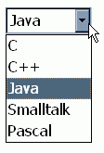
Combo Box
<select name="language">
<option value="c">C</option>
<option value="c++">C++</option>
<option value="java" selected>Java</option>
<option value="smalltalk">Smalltalk</option>
<option value="pascal">Pascal</option>
</select>
Element: select
Attributes
  name: name of this form element
  Other optional attributes: disabled, multiple, size
Purpose
  To allow users to select one of many items
Element: option
Attributes
  value: value corresponding to the list item
  selected: Set initial selected item
Purpose
  To specify a list item

Slide 22
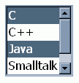
Selectable List
<select name="language" multiple size="4">
<option value="c" selected>C</option>
<option value="c++">C++</option>
<option value="java" selected>Java</option>
<option value="smalltalk">Smalltalk</option>
<option value="pascal">Pascal</option>
</select>
Element: select
Attributes
  name: name of this form element
  multiple: When appear in tag, allows multiple selection
  size: Number of visible list items in the list
  Other optional attributes: disabled
Purpose
  To allow users to select zero or more items from a list

Slide 23
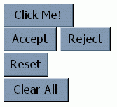
Regular, Reset, and Submit Buttons
<input type="button" value="Click Me!"><br>
<input type="submit" name="accept" value="Accept">
<input type="submit" name="reject" value="Reject"><br>
<input type="reset"> <br>
<input type="reset" value="Clear All"><br>
Element: input
Attributes
  type: must be one of "button", "submit", and "reset"
  value: Text to appear on the buttons
    If omitted for submit buttons, the default value of "Submit" is used
    If omitted for reset buttons, the default value of "Reset" is used
  Other optional attributes: name, disabled
Purpose
  type="button": To initiate an action such as executing a Javascript code
  type="submit": To send the form data
  type="reset": to clear the form data and set them to their initial state

Slide 24

Another Kind of Buttons
<button type="button"><i>Hello!</i></button>
<br>
<button type="submit">Accept</button>
<br>
<button type="reset"><b>Reset</b></button>
<br>
Element: button
Attributes
  type: "button", "submit", or "reset" (default is "button")
  Other optional attributes: name, value, disabled
Can be used to create fancier looking buttons.
  Between the <button>…</button>, one can place image, text that spans multiple lines, or both.

Slide 25
Other Controls and Options
File upload controls
  Lets user select a file and send it to the server
Server-side image maps
  User clicks on an image and form gets submitted
  Form data are sent as name.x=x-pos&name.y=y-pos
Hidden fields
  Represent name and value pair in a form
  For keeping some "variables" in the form
Grouping Controls
  fieldset lets you visually group form elements.

Slide 26
HTML5 New Input Controls
Email
URL
Number
Range
Date pickers (date, month, week, time, datetime, datetime-local)
Search
Color

Slide 27
HTML5 New Form Attributes
autocomplete
autofocus
form
formaction
formenctype
formmethod
formnovalidate
formtarget
height and width
list
min and max
multiple
pattern (regexp)
placeholder
required
step
See: http://www.w3schools.com/html/html_form_attributes.asp

Slide 28
Note
The appearance of the input controls are browser/platform specific.

Slide 29
HTML Forms - Summary
General process
  Form uses action to specify base URL
  Form elements each have a name
  Form data are submitted to the server as "name" and "value" pairs using either HTTP GET or HTTP POST method.
Add a submit button to allow a user to initiate form submission (when no JavaScript is involved)
Note: A HTML document can contain multiple forms.
You can find more form examples at w3schools.

